Slide 1
Project Evaluation

Slide 2
Project Evaluation
Project evaluation is about deciding whether a project is worth doing, by comparing it with other alternatives (including “do nothing”).
Usually done at Step 0 of Step Wise planning → during project selection phase.
Project evaluation is how they check if an idea is:
Strategic: Does it help us reach our long-term company goals? (e.g., become the best phone company?)
Technical: Can we actually build it with our skills and tools?
Economic: Will it make money or save money? Is it worth the cost?

Slide 3
Strategic Assesment
Step-1: Identify Project Scope and Objectives
1.1 Identify objectives and measures of effectiveness
Objective: Automate attendance tracking.
Measure: Reduce manual errors by 90% within 3 months.
1.2 Establish a project authority
Example: The Head of the CSE Department is appointed as the project authority.
1.3 Identify stakeholders and their interests
Faculty: Quick and easy attendance marking.
Students: View attendance history.
Admin: Generate monthly reports.

Slide 4
Strategic Assessment
· Objectives: "How will this system specifically help us ensure students attend classes, improve record-keeping accuracy, and help identify at-risk students sooner?“
· Existing Systems (IS Plan): "Will this attendance system integrate with our existing Student Information System (SIS)? Can it share data with our learning management system (LMS)?“
· University/School Structure: "Who will be responsible for managing this system? Will teachers need specific training? How will it affect the administrative staff who currently handle attendance records?"
2

Slide 5
Strategic Assessment
· Information (MIS): "What kind of reports will this system generate (e.g., daily attendance, absentee lists, trends over time)? Will it help deans or advisors intervene more effectively?“
· Personnel: "Do our IT staff have the skills to support this new system? Will all faculty and administrative staff need training on how to use it?“
· Image: "How will this system affect the perception of the school by students and parents? Will it be seen as a modern, efficient tool, or as an intrusive 'big brother' system?" (Especially relevant if using biometric attendance).

Slide 6
Portfolio Management
Projects are the individual pieces, Programmes group related projects for a bigger goal, and a Portfolio is all the projects and programmes an organization is doing.
Portfolio Management as the process of making top-level decisions about what projects and programmes an organization should undertake to achieve its overall strategic goals. It's about selecting, prioritizing, balancing, and controlling the entire collection of investments.
Strategic Assessment is the "Filter" for Portfolio Management

Slide 7
Technical Assessment
Technical Assessment is a detailed evaluation of whether a proposed software or information system can be successfully developed and implemented using the existing or planned hardware, software, networks, and human resources.
It ensures that the system is technically feasible and aligns with the organization’s IT environment and strategy.
Purpose of Technical Assessment
To verify technical feasibility before investing resources.
To identify technical challenges or incompatibilities.
To check whether existing infrastructure supports the new system.
To narrow down solution options based on technical constraints.

Slide 8
Cost-Benefit Analysis
Cost-Benefit Analysis is a structured method used to evaluate whether a project is economically viable.
It compares the expected costs of a project with the benefits it is expected to deliver, both expressed in monetary terms.
Cost-benefit analysis consists of 2 steps
Step 1: Identify and Estimate Costs and Benefits
Step 2: Express Costs and Benefits in Common Units (Money)

Slide 9
Cost-Flow Forecasting
Costs are typically divided into:
Development Costs – Salaries of the development team, tools, software licenses.
Setup Costs – Buying servers, hiring trainers, migrating data.
Operational Costs – Ongoing maintenance, electricity, salaries post-deployment.
Benefits are usually categorized as:
Direct Benefits – e.g., reduced labor costs due to automation.
Assessable Indirect Benefits – e.g., fewer errors due to better UI.
Intangible Benefits – e.g., improved employee morale or brand reputation.

Slide 10
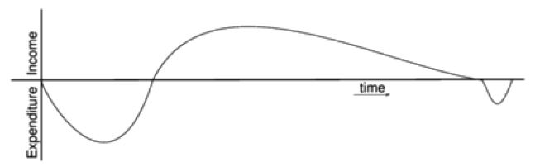
A cash flow forecast shows:
When money will be spent (costs)
When income or benefits will be received (benefits)

Slide 11
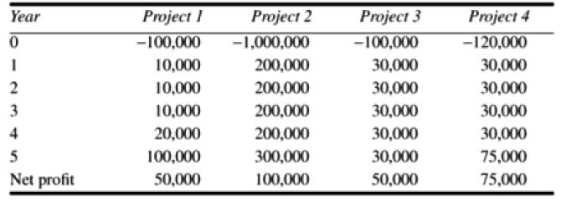
Negative values → Expenditure
Positive Values → Income

Slide 12
Cost-benefit evaluation techniques
1. Net Profit
Formula:
Net Profit=Total Benefits−Total Costs
What it tells: The amount of money you gain (or lose) over the entire project lifecycle.
Limitations:
Ignores when the money comes in (timing).
Prefers larger profits, even if they come much later.
Example:
Project A: Costs £100,000, returns £150,000 → Net profit = £50,000
Project B: Costs £20,000, returns £60,000 → Net profit = £40,000 Project A has higher net profit, but B may still be better based on other factors.

Slide 13
Cost-benefit evaluation techniques
2. Payback Period
Definition: The time taken to recover the initial investment (i.e., to "break even").
Why use it: Shorter payback period = quicker recovery = less risk.
Formula: Count the years until the cumulative cash inflow equals the initial cost.
Limitation:
Ignores total profit after break-even point.
Doesn't consider time value of money.

Slide 14
Cost-benefit evaluation techniques
3. Return on Investment (ROI)
Formula:
ROI=(Average Annual Profit/Total Investment)×100
Why use it: Compares profitability relative to how much you spent. Higher ROI = better efficiency of investment.
Limitation:
Ignores timing of cash flows.
Doesn't reflect project risk.

Slide 15

Cost-benefit evaluation techniques
3. Net Present Value (NPV)
NPV is a method to measure how profitable a project is by considering:
The money you will earn from the project in the future.
The cost of the project today.
The fact that money loses value over time (because of inflation, risk, etc.).

Slide 16
Cost-benefit evaluation techniques
Simple Idea: NPV is a financial calculation that helps us decide if a project is a good investment by figuring out if the money we expect to gain from it in the future is worth more than the money we have to spend on it today.
The Goal: It converts all future money (cash inflows and outflows) into what it would be worth today.
“NPV shows if a project is really worth it by comparing future earnings to today’s cost.”

Slide 17
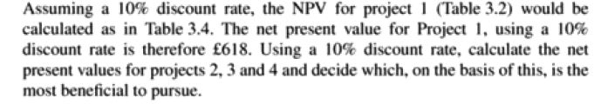
Cost-benefit evaluation techniques

Slide 18
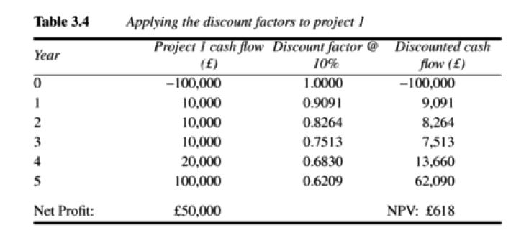
Cost-benefit evaluation techniques

Slide 19
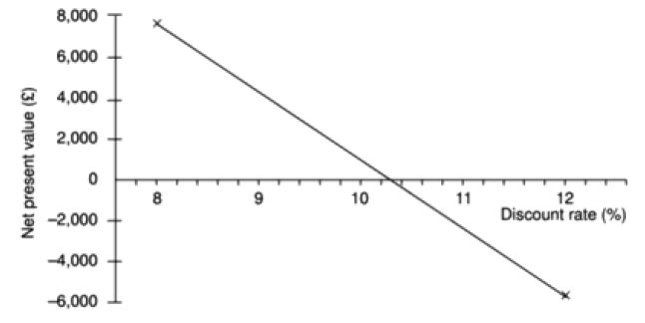
Cost-benefit evaluation techniques
Internal Rate of Return (IRR) is the discount rate at which the Net Present Value (NPV) of all cash flows from a project becomes zero.

Slide 20
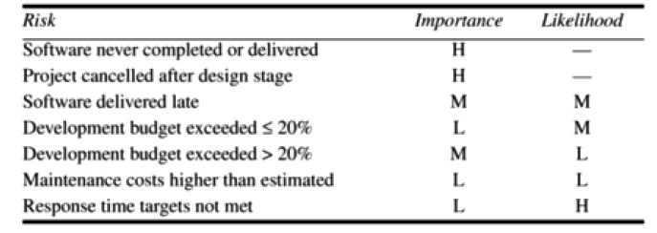
Risk Evaluation
Risk Identification and Ranking

Slide 21
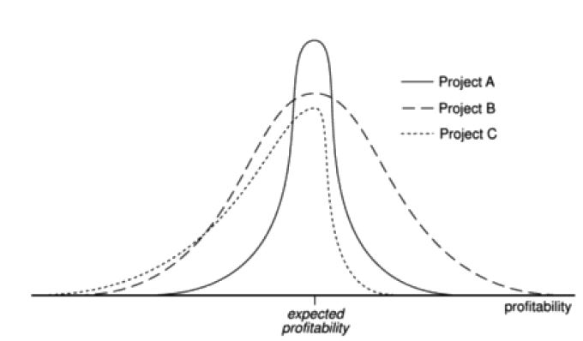
Risk Profile Analysis

Slide 22
Decision Tree-based Approach
What is a Decision Tree?
A visual and analytical tool used to evaluate different choices under uncertainty.
Helps in making informed decisions based on possible outcomes and associated probabilities.
Why Use Decision Trees in Project Evaluation?
To assess risk in uncertain conditions
To compare expected Net Present Values (NPVs) of different strategies
To consider both probability and impact of each outcome

Slide 23
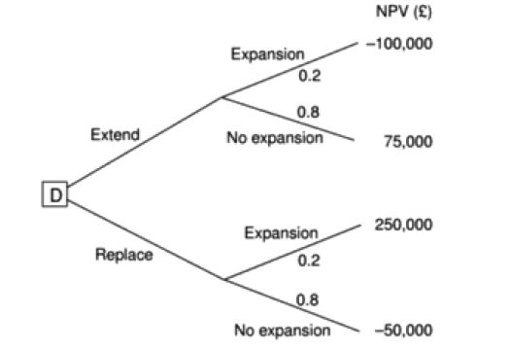
Decision Tree-based Approach

Slide 24
Decision Tree-based Approach
Structure of the Decision Tree
Decision Node (■) – The square at the start represents the choice between "Extend" or "Replace".
From each decision, you branch out to Chance Nodes (●), which represent uncertainty:
e.g., "Market expands" (with 20% probability)
or "Market does not expand" (with 80% probability)
Each path leads to an Outcome Value (NPV) — the financial result of that situation.

Slide 25
Decision Tree-based Approach
Option A: Extend system
If market expands (20% chance): NPV = –£100,000
If market does not expand (80% chance): NPV = £75,000
Expected Value:
(0.2×−100,000)+(0.8×75,000)=−20,000+60,000=£40,000
Option B: Replace system
If market expands (20% chance): NPV = £250,000
If market does not expand (80% chance): NPV = –£50,000
Expected Value:
(0.2×250,000)+(0.8×−50,000)=50,000−40,000=£10,000

Slide 26
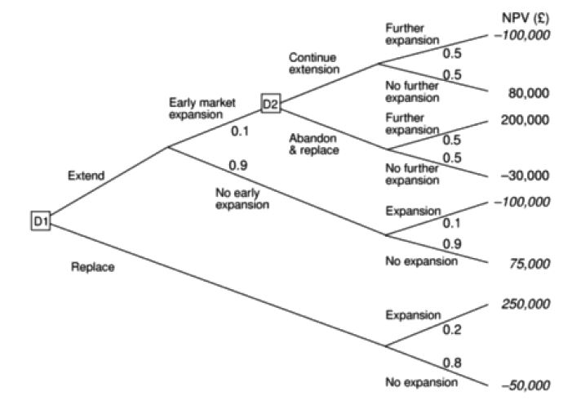
Decision Tree-based Approach

Slide 27
Decision Tree-based Approach
D1 – Initial Decision:
Extend the current system
Replace the system with a new one
If Replaces:
20% chance that the market expands ⇒ NPV = £250,000
80% chance of no expansion ⇒ NPV = –£50,000
Expected NPV from Replace:
(0.2×250,000)+(0.8×(−50,000))=50,000−40,000=£10,000

Slide 28
Decision Tree-based Approach
If Extends:
First, market outcome is observed:
Case 1: Early Market Expansion (10% chance)
→ Go to Decision Point D2:
Amanda can now choose to:
Continue Extension:
50% chance: Further Expansion → NPV = –£100,000
50% chance: No further expansion → NPV = £80,000
Expected Value:
0.5×(−100,000)+0.5×80,000=−50,000+40,000=−£10000
Abandon and Replace:
50% chance: Further Expansion → NPV = £200,000
50% chance: No further expansion → NPV = –£30,000
Expected Value:
0.5×200,000+0.5×(−30,000)=100,000−15,000=£85,000

Slide 29
Decision Tree-based Approach
So at D2, the decision will be Abandon and Replace.
Case 2: No Early Expansion (90% chance)
10% chance market expands later → NPV = –£100,000
90% chance it doesn’t → NPV = £75,000
Expected Value:
0.1×(−100,000)+0.9×75,000=−10,000+67,500=£57,500

Slide 30
Decision Tree-based Approach
Final Expected Value for “Extend” Option:
Now combine both branches (from Extend):
10% chance of Early Expansion → best option is Abandon & Replace = £85,000
90% chance of No Early Expansion → £57,500
(0.1×85,000)+(0.9×57,500)=8,500+51,750=£60,250

